Slide 1
ML Algorithmic Trading
FinTech Butlers
Michelle Silver
Malika Ajmera
Matt Glasgow
Joseph Knight
Mike Nguyen
Luis Torres
University of California Berkeley FinTech Bootcamp : Project 2
July 2023

Slide 2
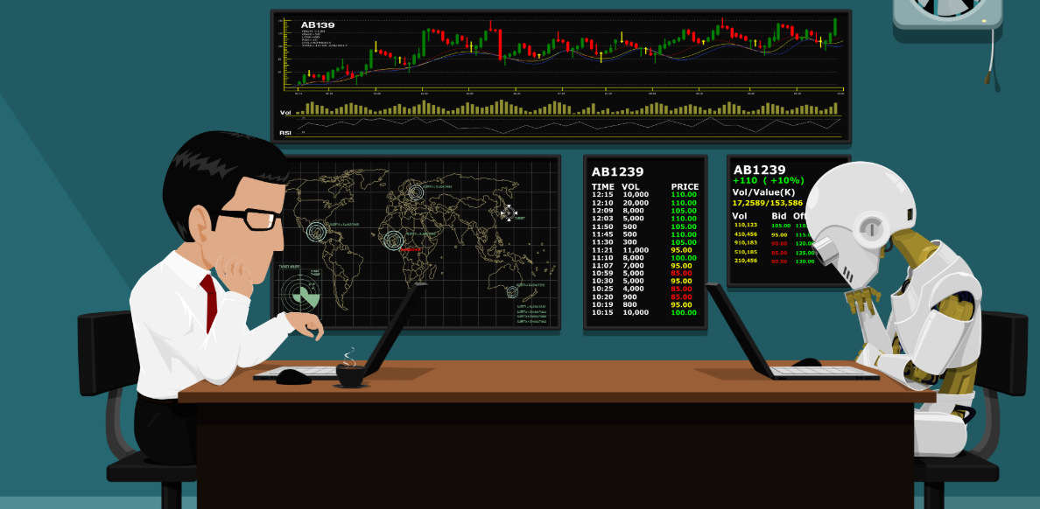
EXECUTIVE SUMMARY
ML Algorithmic Trading Project
Objective: Build predictive models using machine learning algorithms for buy-sell decision making
Why?
Help develop profitable trading strategies based on machine learning model results
How?
Leveraging historical stock data from yfinance, TA-lib technical analysis library, & various machine learning models
Notes:
Mike to present

Slide 3
MACHINE LEARNING: APPROACH
Data Collection
Data Preprocessing
Feature Engineering
Label Generation
Collect Historical Data
from yfinance
Clean & Preprocess Data
(e.g. scale / normalize, dropna)
Technical Indicators (e.g. from TA-lib,
Technical Analysis Library)
Buy / Sell Trading Signals
(based on trading strategies)
1
2
3
4
Model Selection
Model Training
Model Evaluation
Model Deployment
Based on problem (i.e. classification or regression)
Train based on input features (x) and generated labels (y)
Evaluate models based on metrics (Classification: Accuracy, F1-score, etc.)
Deploy model once satisfied with performance
(after refinements & iterations)
5
6
7
8
Notes:
Mike to present

Slide 4
MACHINE LEARNING MODELS
Model | Description | Variables | Challenges | Results | Conclusion
SVC Classifier | Good for high dimensional spaces | Signal - 10d stock price change, SMAs, RSI, MACD, P/E | Deciding variables and indicator | Accuracy Score: .72 | Promising Evaluation Metrics
Decision Tree Classifier | Model that builds flowchart-like tree structure | Signal - 10d stock price change, SMAs, RSI, MACD, P/E | Deciding variables and indicator | Accuracy Score: .85 | Promising Evaluation Metrics
Random Forest Classifier | Predict Buy / Sell Trading Signals (Classification Model) | Relative Strength Index (RSI) Close Price | Multiple iterations required to improve performance (e.g. adjust data time frame, overbought / oversold thresholds) | Accuracy Score: .98 | Promising Evaluation Metrics
AdaBoostClassifier (AbC-3Y-7030) | Fits a base or weak learner to the training data. Assigns equal weights to each training example iteratively training multiple weak learners | 3Y SPY closing prices Short window = 4 days Long Window = 100 days 70/30 training split | Training/Testing split using trading days | Accuracy: Training : 70% Test: 50% | Useful when features don’t provide enough info to the model Increase training split (e.g. 80/20) to improve performance
Notes:
Matt to present
Classification Models (Buy/Sell) vs Regression Models (Predict Future Prices)
Tested 20+ models with varying parameters/inputs
Historical data from 1-10 years, Short-term windows, long-term windows, shifts from 1-10 days
Worked on understanding the types of indicators and which indicators possibly pair with others

Slide 5
MACHINE LEARNING MODELS
Model | Description | Variables | Challenges | Results | Conclusion
Long Short-Term Memory (LTSM) Neural Network | Predict Price of Stock & Returns (Regression Model) | SPY data (3Y) Closing price 80/20 Split | Understanding the LSTM model itself and what parameters to choose | Train Loss: 0.0014 Test Loss: 0.00061 MSE - loss: 0.0019 | Works best for time series analysis
Logistic Regression (LogReg-3Y7030) | Models the relationship between the features and the probability of the target variable belonging to a specific class. It is a classification, not a regression algorithm | 3Y SPY closing prices Short window = 4 days Long Window = 100 days 70/30 training split | Training/Testing split using trading days | Training : 56% Test: 24% Poor recall on sell signal | Do not use Try a different Model ( see AdaBoostClassifier)
SVC Classifier | Predict Buy / Sell Trading Signals based (Classification Model) | Force Index Close.diff * Volume | The sudden spikes in the direction of the price moment can help confirm the breakout. Inverse the signal | Accuracy Score: 0.49 | Confirmation indicator
Notes:
Matt to present

Slide 6
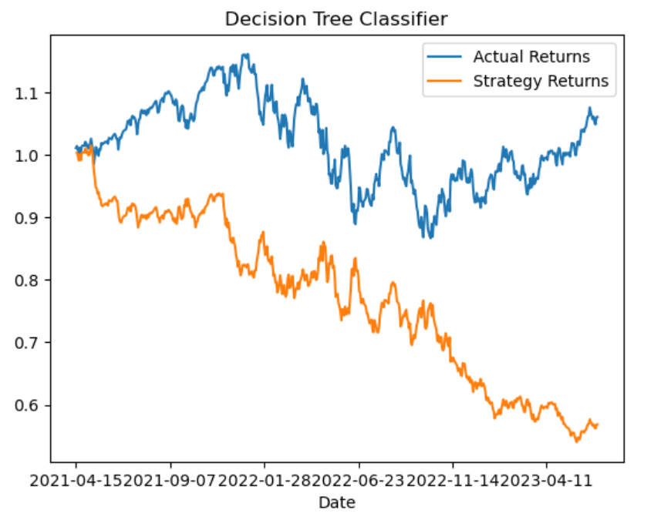
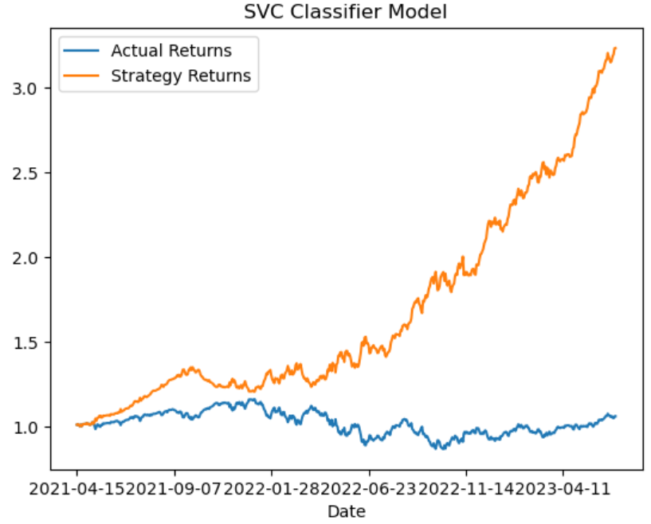
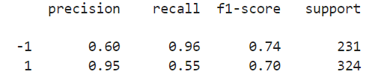
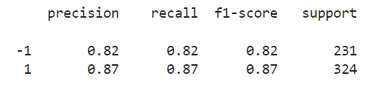
RESULTS & CONCLUSION
Notes:
Michelle to present

Slide 7
NEXT STEPS
Questions
Future Research
Future Releases
Are there other pairs of indicators that will produce better results?
What accuracy score is sufficient?
What model loss is acceptable?
Explore other machine learning models
Runtime/ Resource efficiency
Test on other asset classes, stocks and sectors
Test on ‘paper trading’ mode
Add UI/UX
API integration
Deploy to the cloud
Blockchain record keeping
Notes:
Luis to present

Slide 8

LINKS
GitHub repo: P2_ML_AlgoTrade
Presented Models in <main branch>
All other models in dev branches (5)

